Slide 1
SQL Server Index Structure
Module 5

Slide 3
Learning Units covered in this Module
Lesson 1: Index Internals
Lesson 2: Index Strategy
Lesson 3: Index Monitoring and Fragmentation

Slide 4
Lesson 1: Index Internals

Slide 5

Objectives
After completing this learning, you will be able to:
Understand differences between heap and clustered objects.
Describe B-Trees, and why they are beneficial.
Understand the differences between clustered and non-clustered indexes.
Describe the different methods by which data structures are accessed.

Slide 6

What is an Index?
An index is an on-disk structure associated with a table that speeds retrieval of rows.
An index contains keys built from one or more columns in the table.
Notes:
In relational databases, a condition (or predicate) in a query is said to be sargable if the DBMS engine can take advantage of an index to speed up the execution of the query. The term is derived from a contraction of Search ARGument ABLE.
For further information refer to:
https://en.wikipedia.org/wiki/Sargable

Slide 7

What is SARGability?
A SARGable item in a search predicate is able to use an index.
Non-SARGable expressions can significantly slow down queries.
Notes:
In relational databases, a condition (or predicate) in a query is said to be sargable if the DBMS engine can take advantage of an index to speed up the execution of the query. The term is derived from a contraction of Search ARGument ABLE.
For further information refer to:
https://en.wikipedia.org/wiki/Sargable

Slide 8
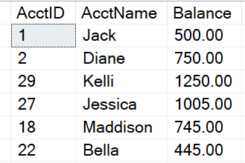
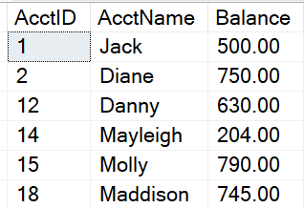
How Data is Stored in Data Pages
Heap
Data stored in a Heap is not stored in any order and normally does not have a Primary Key.
Clustered Index
Clustered Index data is stored in sorted order by the Clustering key. In many cases, this is the same value as the Primary Key.

Slide 9
Heap
A heap is a table without a clustered index
Unordered masses of data
Can be good for quickly importing large sets of data
Not a good idea for production-level data structures
Use the ALTER TABLE…REBUILD command to “rebuild” a heap table
Do not use a heap
When the data is frequently returned in a sorted order.
When the data is frequently grouped together.
When ranges of data are frequently queried from the table.
When there are no nonclustered indexes and the table is large.
Notes:
Key Points :
Heaps are typically a poor choice for production structures because:
Forwarding pointers.
8-byte Row-ID assigned on insert. RID consisting of the file number, data page number, and slot on the page.
Not great at all for table scans.
Sometimes expensive to find a spot where a row can be inserted.
Data pages are not linked, so sequential access needs to refer to the index allocation map (IAM) pages.
=============
More Information
=============
A heap is a table without a clustered index. One or more nonclustered indexes can be created on tables stored as a heap. Data is stored in the heap without specifying an order. Usually data is initially stored in the order in which the rows are inserted into the table, but the Database Engine can move data around in the heap to store the rows efficiently; so the data order cannot be predicted. To guarantee the order of rows returned from a heap, you must use the ORDER BY clause. To specify the order for storage of the rows, create a clustered index on the table, so that the table is not a heap.
When Not to Use a Heap
Do not use a heap when the data is frequently returned in a sorted order. A clustered index on the sorting column could avoid the sorting operation.
Do not use a heap when the data is frequently grouped together. Data must be sorted before it is grouped, and a clustered index on the sorting column could avoid the sorting operation.
Do not use a heap when ranges of data are frequently queried from the table. A clustered index on the range column will avoid sorting the entire heap.
Do not use a heap when there are no nonclustered indexes and the table is large. In a heap, all rows of the heap must be read to find any row.

Slide 10
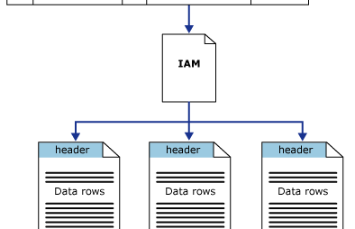
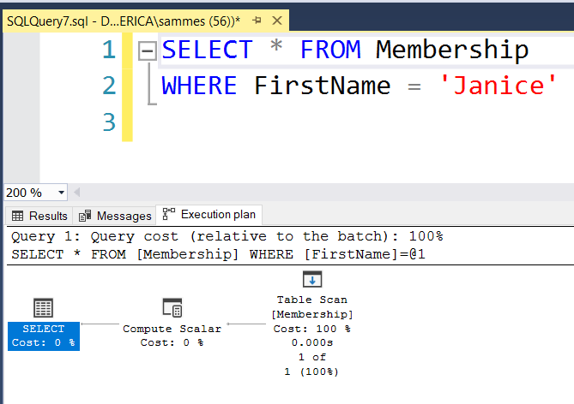
Heap Structures
Heaps have one row in sys.partitions, with index_id = 0 for each partition used by the heap
Notes:
Key Points:
Table scans or serial reads of a heap can be performed by scanning the IAM pages to find the extents that are holding pages for the heap.
Because the IAM represents extents in the same order that they exist in the data files, this means that serial heap scans progress sequentially through each file.
Using the IAM pages to set the scan sequence also means that rows from the heap are not typically returned in the order in which they were inserted.
Queries retrieving data from Heap objects will read all pages on that table. This is a very expensive operation.
=============
More Information
=============
The Diagram in slide illustrates how the SQL Server Database Engine uses IAM pages to retrieve data rows in a single partition heap.
Depending on the data types in the heap, each heap structure will have one or more allocation units to store and manage the data for a specific partition.
At a minimum, each heap will have one IN_ROW_DATA allocation unit per partition.
The heap will also have one LOB_DATA allocation unit per partition, if it contains large object (LOB) columns.
It will also have one ROW_OVERFLOW_DATA allocation unit per partition, if it contains variable length columns that exceed the 8,060 byte row size limit.
The column first_iam_page in the sys.system_internals_allocation_units system view points to the first IAM page in the chain of IAM pages that manage the space allocated to the heap in a specific partition.
SQL Server uses the IAM pages to move through the heap.

Slide 11
Clustered Indexes
An ordered data structure that is implemented as a Balanced (B) Tree.
When a table is clustered, the leaf level of the index contains ALL data in the table. This means that the clustered index IS the table. This is also why there is only one per table.
The leaf level of the clustered index contains data pages.
Notes:
Clustered Index
Implemented as an Inverted Balanced (B) Tree, or B-Tree.
The top of the B-Tree contains the ROOT Level. Contains range of key values and indication of location for those key ranges.
Intermediate Level(s) are located below Root Level
Contain finer grain key distribution.
Number of Intermediate levels is proportional to Cluster Key width, and the number of rows.
A small Clustered Table may not have Root or Intermediate level(s).
Leaf Level contains the actual data pages.

Slide 12
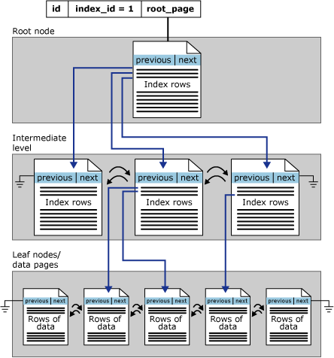
Clustered Index Structure
Leaf Node Contains Data Pages
Notes:
Clustered Index
Implemented as an Inverted Balanced (B) Tree, or B-Tree.
The top of the B-Tree contains the ROOT Level. Contains range of key values and indication of location for those key ranges.
Intermediate Level(s) are located below Root Level
Contain finer grain key distribution.
Number of Intermediate levels is proportional to Cluster Key width, and the number of rows.
A small Clustered Table may not have Root or Intermediate level(s).
Leaf Level contains the actual data pages.

Slide 13

Demonstration
Examining index metadata and Building a B-Tree
This demonstration reviews index, partition, and allocation unit metadata.
Show how a B-Tree begins to form as rows are added to a table.
Notes:
Previous demonstration files are under E:\Archived.
You can open all the demonstrations by using the solutions file :
E:\Demos\SQL_PTO_Workshop_Demos.ssmssln
Individual SQL demo files.
E:\Demos\05_Indexing_Strategy\Examine_Index_MetaData.sql
E:\Demos\05_Indexing_Strategy\Building_a_B-Tree.sql

Slide 14
Non-Clustered Indexes
Same B-tree data structure as a clustered index.
It is an independent structure that is created from a Heap or Clustered Index.
Only contains a subset of the columns in the base table
The leaf level contains only the columns defined in the index as well as the clustered key/heap ID that points to the base table structure.
Notes:
Non-Clustered Index
Same B-tree data structure as in a clustered index, except for Leaf Level.
Non-Clustered Index Data is kept in synch with base table, but its data is stored separately.
Contains a subset of the columns in the base table.
Think of it as a skinny table that is really fast for searching and sorting.
Most likely far fewer pages in a NC index as compared to a Clustered table.
Leaf level contents:
Columns defined in the index key.
A ‘pointer’ to link back to the base table (to retrieve additional data).
clustered key for Clustered Objects or
ROW ID for heap objects
Any Included Columns
As Leaf level contains fewer columns in comparison to base table, Non-Clustered indexes have fewer pages than the corresponding base table.
References https://docs.microsoft.com/en-us/sql/relational-databases/sql-server-index-design-guide?view=sql-server-ver15

Slide 15

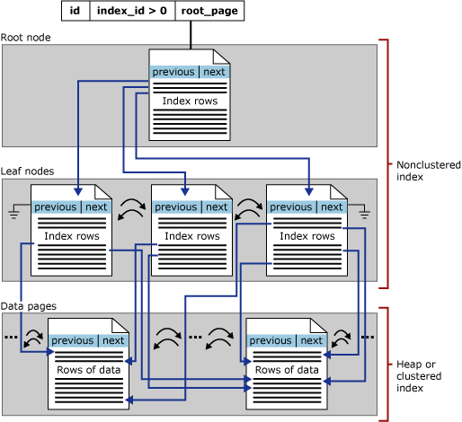
Non-Clustered Index Structure
Leaf Node has Pointers to Base Table
Base Table (Heap or Clustered Index

Slide 16
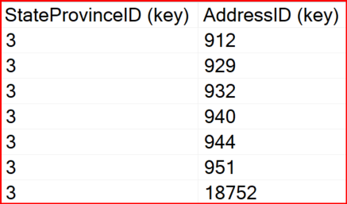
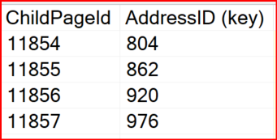
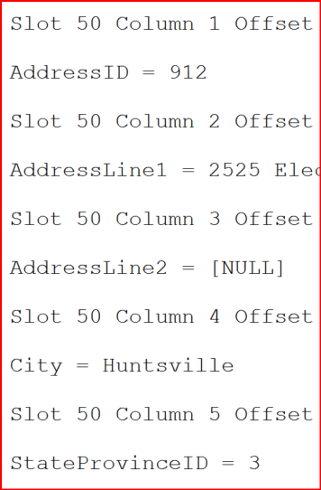
Non-Clustered Index Structure
Non-Clustered Index
Leaf Level
Clustered Index
Non-Leaf Level
--SELECT * will need to find all columns
SELECT *
FROM Person.Address
WHERE StateProvinceID = 3
Data Page 11855
Leaf Level

Slide 17
Demonstration
Non-Clustered Indexes
Looks inside a non-clustered index.
Notes:
Previous demonstration files are under E:\Archived.
You can open all the demonstrations by using the solutions file :
E:\Demos\SQL_PTO_Workshop_Demos.ssmssln
Individual SQL demo files.
E:\Demos\05_Indexing_Strategy\NCI_Covering_Includes

Slide 18
Clustered vs Nonclustered Indexes
An index is an on-disk structure associated with a table or view that speeds retrieval of rows.
Clustered Indexes
Leaf level has data rows stored with index.
Non-clustered Indexes
Separate structure from base table.
Contains a pointer back to base table called:
“Skinny” data structure as it contains a subset of base table only.
To by-pass index key limits (1,700 bytes) ,non-key columns can be added to leaf level.
As Leaf level contains fewer columns than base table, the non-clustered index uses fewer pages than the corresponding base table.
Row ID (RID when base table is HEAP)
Key (KEY when base table is Clustered)
Table data can be sorted in only one way.
Defines the order in which data is physically stored in a table.
When a table has a clustered index, the object is called clustered table.
Cluster key is added to nonclustered index (as the pointer), keep it as narrow as possible.
Notes:
Clustered
Clustered indexes sort and store the data rows in the table or view based on their key values. These are the columns included in the index definition. There can be only one clustered index per table, because the data rows themselves can be stored in only one order.
The only time the data rows in a table are stored in sorted order is when the table contains a clustered index. When a table has a clustered index, the table is called a clustered table. If a table has no clustered index, its data rows are stored in an unordered structure called a heap.
Nonclustered
Nonclustered indexes have a structure separate from the data rows. A nonclustered index contains the nonclustered index key values and each key value entry has a pointer to the data row that contains the key value.
The pointer from an index row in a nonclustered index to a data row is called a row locator. The structure of the row locator depends on whether the data pages are stored in a heap or a clustered table. For a heap, a row locator is a pointer to the row. For a clustered table, the row locator is the clustered index key.
You can add non-key columns to the leaf level of the nonclustered index to by-pass existing index key limits, and execute fully covered, indexed, queries. For more information, see Create Indexes with Included Columns. For details about index key limits see Maximum Capacity Specifications for SQL Server.
Both clustered and nonclustered indexes can be unique. This means no two rows can have the same value for the index key. Otherwise, the index is not unique and multiple rows can share the same key value. For more information, see Create Unique Indexes.
Indexes are automatically maintained for a table or view whenever the table data is modified.
See Indexes for additional types of special purpose indexes.
References : https://docs.microsoft.com/en-us/sql/relational-databases/indexes/clustered-and-nonclustered-indexes-described?view=sql-server-ver15

Slide 19
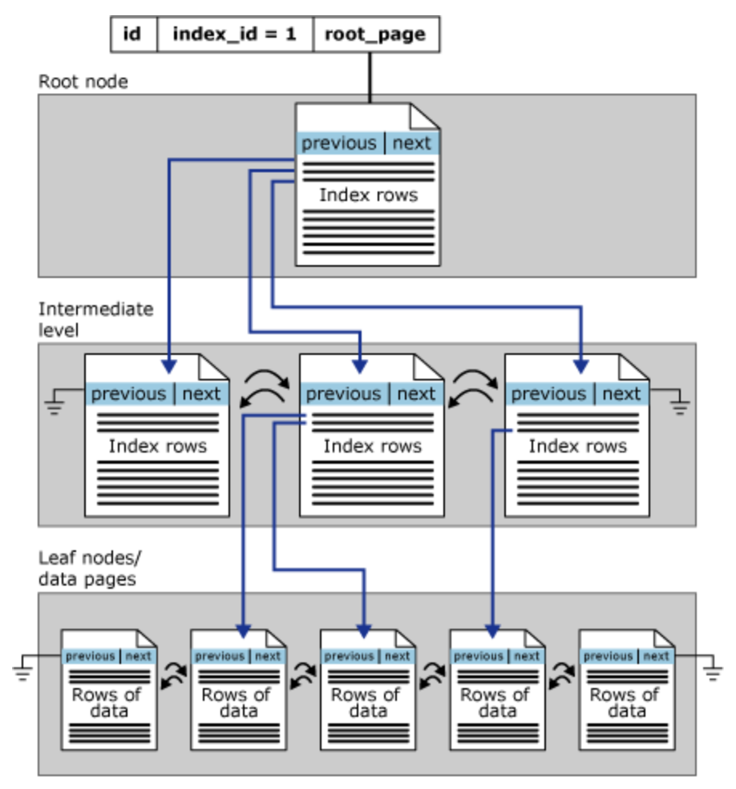
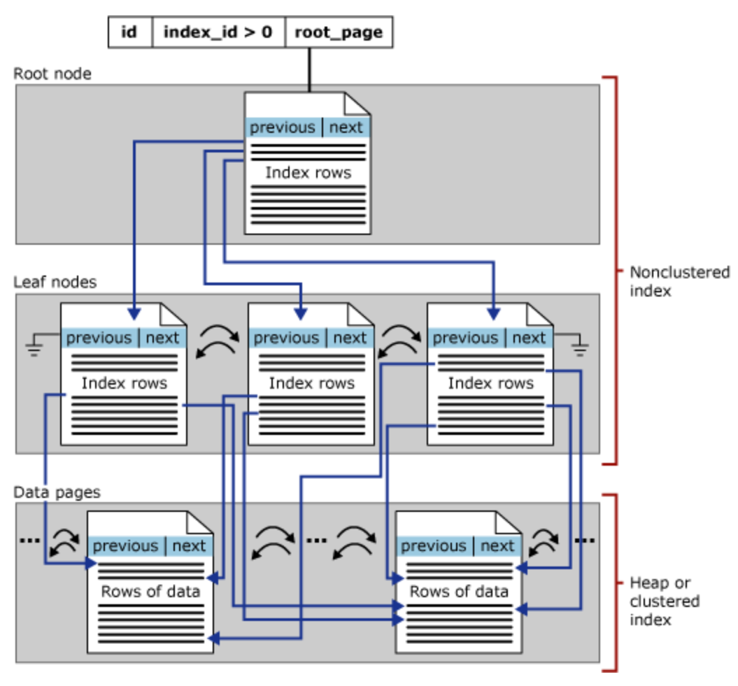
Comparing Clustered and Non-clustered indexes
Leaf Node has Pointer to Base Table
Leaf Node Contains Data Pages
Clustered Index
Nonclustered Index
Notes:
Clustered Index
Implemented as an Inverted Balanced (B) Tree, or B-Tree.
The top of the B-Tree contains the ROOT Level. Contains range of key values and indication of location for those key ranges.
Intermediate Level(s) are located below Root Level
Contain finer grain key distribution.
Number of Intermediate levels is proportional to Cluster Key width, and the number of rows.
A small Clustered Table may not have Root or Intermediate level(s).
Leaf Level contains the actual data pages.
Non-Clustered Index
Same B-tree data structure as in a clustered index, except for Leaf Level.
Non-Clustered Index Data is kept in synch with base table, but its data is stored separately.
Contains a subset of the columns in the base table.
Think of it as a skinny table that is really fast for searching and sorting.
Most likely far fewer pages in a NC index as compared to a Clustered table.
Leaf level contents:
Columns defined in the index key.
A ‘pointer’ to link back to the base table (to retrieve additional data).
clustered key for Clustered Objects or
ROW ID for heap objects
Any Included Columns
As Leaf level contains fewer columns in comparison to base table, Non-Clustered indexes have fewer pages than the corresponding base table.
References https://docs.microsoft.com/en-us/sql/relational-databases/sql-server-index-design-guide?view=sql-server-ver15

Slide 20
Fragmentation
A fragmented table/Index is when some of its data pages point to pages that are not in sequence.
Logical fragmentation
Occurs when leaf level pages are not physically corresponding to the logical order of the index:
Pages are not in the most efficient order for scanning purposes.
Limits the efficiency of read-ahead scans, but not seeks.
Page density
How full a page is when a rebuild/reorganization occurs.
The fuller a page is, the more likely page splits occur when data is modified.
The less full a page is, the more wasted space in the buffer pool when reading pages.
Notes:
Key Points:
Fragmentation will be covered in detail in coming lessons.
References :
https://social.technet.microsoft.com/wiki/contents/articles/40339.sql-server-what-is-fragmentation.aspx
https://docs.microsoft.com/en-us/sql/relational-databases/pages-and-extents-architecture-guide?view=sql-server-ver15

Slide 21
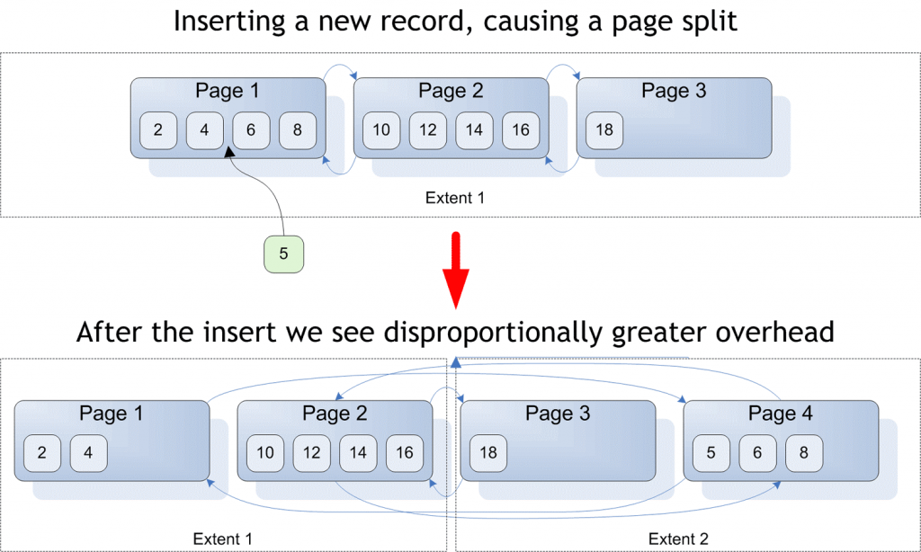
Page Splits
Notes:
Key Points:
Fragmentation will be covered in detail in coming lessons.
References :
https://social.technet.microsoft.com/wiki/contents/articles/40339.sql-server-what-is-fragmentation.aspx
https://docs.microsoft.com/en-us/sql/relational-databases/pages-and-extents-architecture-guide?view=sql-server-ver15

Slide 22

Questions?

Slide 23
Knowledge Check
What are the three access methods reviewed in this lesson?
What are the three different types of allocations?
What is the primary goal of indexing?
Notes:
Answer 1: The three access methods are:
Scans, which read all the data.
Seeks, which read parts of the data by traversing the B-tree to find exactly where to start and stop.
Lookups, which get the columns needed in the select clause when a nonclustered index cannot cover.
Answer 2: In row data, which holds ints, datetimes, and other basic data types.
Strings can be stored in-row data when they fit in the page.
Row overflow data holds strings that are too large to fit in-row data.
LOB data , such as xml, varbinary(max), and varchar(max).
Answer 3: The primary goal of indexing is to reduce logical reads.

Slide 24
Lesson 2: Index Strategy

Slide 25
Objectives
After completing this learning, you will be able to:
Describe best practices associated with clustered index design.
Consider factors involved in designing a nonclustered indexing strategy.
Explain how an indexing strategy can reduce logical reads.

Slide 26
Characteristics of a Good Clustering Key
Narrow
Unique
Static
Increasing
Use a data type with a small number of bytes to conserve space in tables and indexes
To avoid SQL adding a 4-byte uniquifier
Allows data to stay constant without constant changes which could lead to page splits
Allows better write performance and reduces fragmentation issues
Notes:
Further Reading: SQL Server and Azure SQL index architecture and design guide - SQL Server | Microsoft Learn

Slide 27
Best Practices for Clustered indexes
The primary goal of any indexing strategy is to make queries faster
Best Practice | Seeks, not scans | Avoid key lookups | Get most rows on the index page | Get most rows on the data page | Avoid page splits
Use frequently searched value | X | X
Use narrow keys |  |  | X | X
Use unique values |  |  | X | X
Use static values |  |  |  |  | X
Use ascending or descending key |  |  |  |  | X
Notes:
Key Notes:
The primary goal of any indexing strategy is to make queries faster.
Indexes should be present on columns that support the following operations:
Joins
Filtering in the WHERE clause
The ORDER BY clause
=============
More Information
=============
This lesson on indexing strategy is, ultimately, about ways in which indexes can be optimized to ensure that logical reads are minimized, and that those reads are sequential rather than random. The techniques discussed are varied, so it is important to keep these goals in mind.
Best practices for clustered indexes all support the primary or secondary goals of indexing.
The most critical aspect of clustered index design is to select a column that is the most frequently searched for specific values. By doing so, you help ensure that the most common column used to access the table is how the data is sorted, which avoids key lookups and helps ensure that scans will not be needed.
Remember that joins are a common way to search for specific values.
Use narrow keys to ensure that B-trees have as few intermediate levels as possible. This speeds up seeks by reducing the levels of the B-tree that need to be traversed. This also helps nonclustered index seeks, because the clustering key is embedded in the nonclustered index. Another benefit of a narrow clustering key is that the leaf level of nonclustered indexes will store less data per row, which results in fewer pages needed, thereby reducing logical reads when the nonclustered indexes are scanned.
Clustered indexes have to be unique, whether you define them as such or not. If duplicate values are inserted, Microsoft SQL Server inserts a hidden extra column called a uniquifier – a 4 byte int – in those duplicated rows.
This causes the clustering key to be wider, with all the impact just listed above. If you have a lot of duplication, consider adding a second column to the clustering key. You will still have a wider key, but because that column will be embedded in all of the nonclustered indexes, you may be able to cover more queries. If the duplication is minimal, though, adding another column to the key would not be worth it.
If you cluster on a value that gets updated, SQL Server will have to spend time moving the entire row to new locations. If the table has 75 columns, that is a lot of movement, which takes time. Also, the movement causes page splits. Page splits cause fragmentation, which affects scans because data cannot be read sequentially.
Clustering on values that are not naturally ascending or descending also increase page splits.
References
https://docs.microsoft.com/en-us/archive/blogs/josebda/sql-server-2008-indexing-best-practices

Slide 28
Clustered Index vs Primary key considerations
Frequently, clustering on the primary key supports the clustered index best practices
Primary keys are involved in joins to foreign keys
Primary keys are unique
Primary keys are typically ascending
Primary keys are typically not updated
Do not cluster on the Primary key IF:
When table is accessed by other keys than the primary key
Query predicate use Primary Key
Common issue accessing association or child table, when these tables require different primary key than parent table
Use sys.dm_db_index_usage_stats to review data access patterns of index
Notes:
Key Points:
Primary keys are involved in joins to foreign keys, which typically means that you are frequently accessing the data via primary key values.
Frequently, clustering on the primary key supports the clustered index best practices.
Even if primary key meets all the other best practices, if the data is not searched by the primary key, then it is the wrong clustering key.
=============
More Information
=============
Many people associate clustering keys with primary keys and may not be aware that the two are independent concepts.
A primary key simply ensures that each row is unique. It has nothing to do with the way that the data in a table is sorted.
Because they are independent, it is not a requirement that the same key(s) be used for both.
So, why is it such a common practice?
The answer is that a lot of the time, it makes a lot of sense. Primary keys satisfy a lot of clustered index best practices.
In a one-to-many child table, you would typically use parent_id, child_id.
Do not cluster on the Primary key
This is a common problem with association tables and child tables in a one-to-many relationship, in which the typical access is via the parent table’s ID.
If usage stats DMV show little to no index seeks on the clustered key, but a large number of index seeks on the parent ID with key lookups on the clustered index, that is a sign that the clustered key may need to change to the parent ID.
The parent ID is a good choice not only because it is the primary access path to the table. It is also typically ascending, so the rate of fragmentation is likely to be reasonably low.
It often will not be unique, so adding a second column to guarantee uniqueness may be a good idea. In an association table, creating a clustered index on parent1_id, parent2_id works well.

Slide 29
Non-Clustered Index Strategy
Index columns used in WHERE clauses and JOINs.
Keep indexes to a minimum, to minimize impact on DML and log writes.
Two basic approaches: Single column indexes or Multicolumn indexes
Easy to create too many nonclustered indexes.
Specific indexes are appropriate for high-impact queries.
Ideally the focus should be writing queries to use existing indexes, rather than on adding more indexes.
Notes:
Key Points:
Index columns used in WHERE clauses and JOINs
Start with foreign keys, and remove later if not used
This strategy is easy for nonclustered indexes, for any single query. Build an index to support joins and WHERE clauses, and you are done. The challenge comes when you need to address indexing a table with a lot of different queries used against it, each of which may filter on different combinations of columns.
You cannot build specific indexes for every combination of fields that may ever be used, because:
Of storage issues.
A lot of nonclustered indexes would impact DML.
Of the increased maintenance overhead.
=============
More Information
=============
Deciding on an indexing strategy is never easy and is never a one-time effort.
The queries against a table change over time, and therefore, indexing strategies have to be reviewed and adjusted as needed.
Ideally, the first column in a multi-column index will be used in every query. However, that is not likely to happen.
One solution is to create every possible combination of indexes, but that will not scale.
Even though index scans are not as efficient as seeks, the fact is that nonclustered indexes only have a few columns as compared to the clustered index, which could have dozens of columns.
This means that scanning a nonclustered index to find records may result in acceptable query performance.
Ideally the focus should be on writing queries to use existing indexes, rather than on adding more indexes

Slide 30
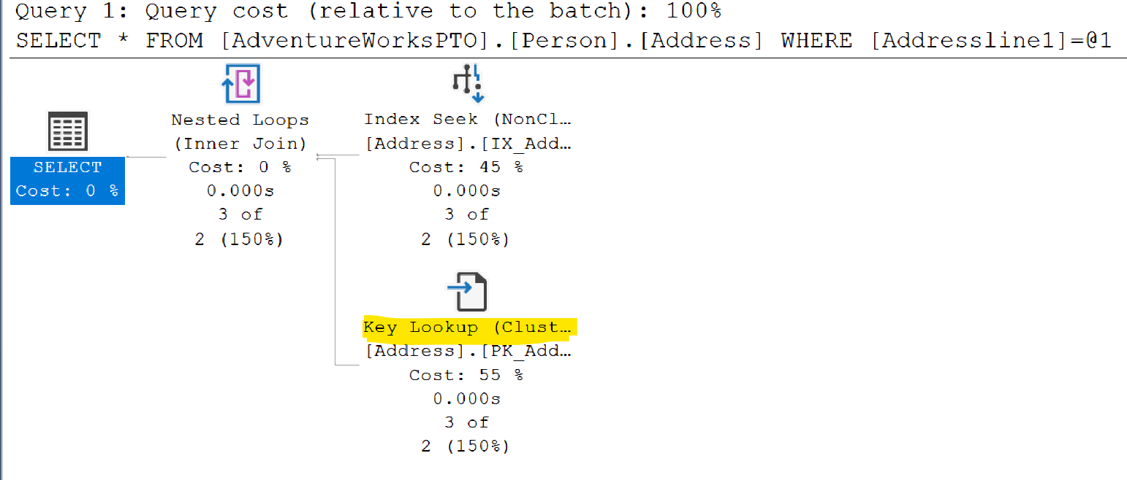
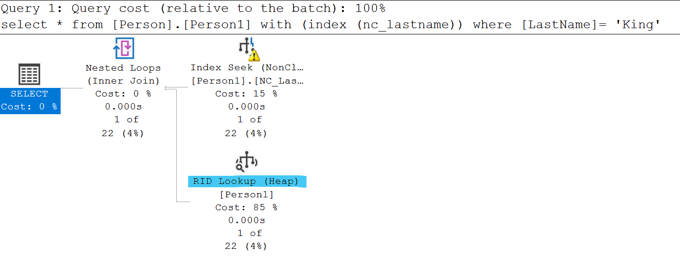
Bookmark Lookup or RID lookup
Occurs when SQL uses a nonclustered index to satisfy all or some of a query’s predicates, but it doesn’t contain all the information needed to cover the query.
Lookup effectively join the nonclustered index back to the clustered index or heap.
If table has clustered index, it is called bookmark lookup (or key lookup)
If the table is a heap with a non-clustered index, it is called RID lookup
This is an expensive operation.
Notes:
Key Points:
When nonclustered indexes are used, SQL Server may choose to use a different access method.
When the nonclustered index is sought or scanned, it is doing so to support WHERE clauses and JOINs.
However, the nonclustered index often cannot support the SELECT clause hence need to join with base table.
To put it another way, it cannot ‘cover’ the query.
=============
More Information
=============
To get the columns needed for the select clause, SQL Server needs to look up those additional columns using a Key Lookup, which reaches back to the clustered index or heap.
This is possible because each row in the nonclustered index has not only the columns that were defined, but also includes the clustering key or RID.
When the nonclustered index seek/scan finds the rows that match the filter requested, it loops over each of the rows, gets the hidden key/RID, and gets the additional columns needed.
Key lookups are costly. In fact, they are so costly that SQL Server frequently decides that the cost of a nonclustered index seek + lookup is higher than simply scanning the clustered index.
To improve Query performance one must remove the lookup from the Execution plan.
The ‘tipping point’ that determines when SQL Server will scan is pretty low, and is typically 10%.
Therefore, avoiding key lookups is often a good way to help query performance. The next lesson, “Indexing Strategy”, discusses ways that this can be done.

Slide 31
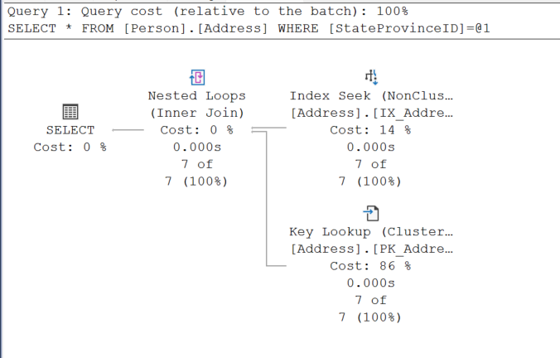
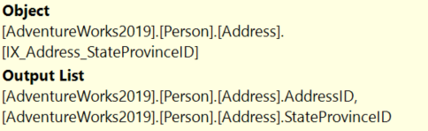
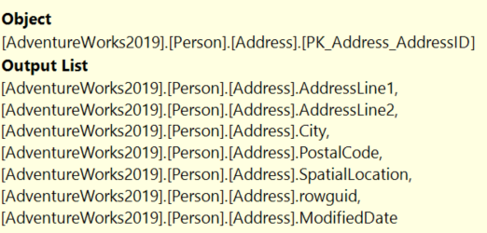
Key Lookup
Notes:
Key Points:
When nonclustered indexes are used, SQL Server may choose to use a different access method.
When the nonclustered index is sought or scanned, it is doing so to support WHERE clauses and JOINs.
However, the nonclustered index often cannot support the SELECT clause hence need to join with base table.
To put it another way, it cannot ‘cover’ the query.
=============
More Information
=============
To get the columns needed for the select clause, SQL Server needs to look up those additional columns using a Key Lookup, which reaches back to the clustered index or heap.
This is possible because each row in the nonclustered index has not only the columns that were defined, but also includes the clustering key or RID.
When the nonclustered index seek/scan finds the rows that match the filter requested, it loops over each of the rows, gets the hidden key/RID, and gets the additional columns needed.
Key lookups are costly. In fact, they are so costly that SQL Server frequently decides that the cost of a nonclustered index seek + lookup is higher than simply scanning the clustered index.
To improve Query performance one must remove the lookup from the Execution plan.
The ‘tipping point’ that determines when SQL Server will scan is pretty low, and is typically 10%.
Therefore, avoiding key lookups is often a good way to help query performance. The next lesson, “Indexing Strategy”, discusses ways that this can be done.

Slide 32
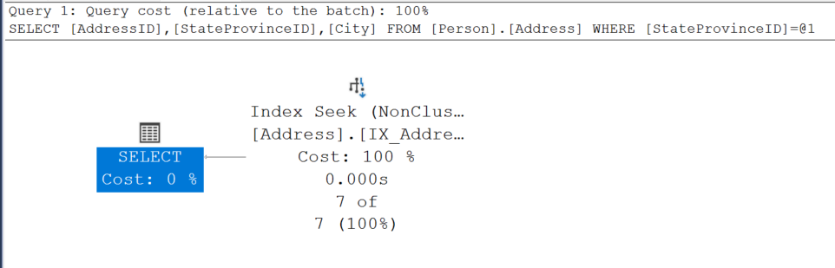
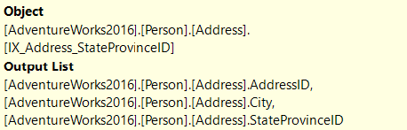
Non-Clustered Index with Included Column
Notes:
Key Points:
When nonclustered indexes are used, SQL Server may choose to use a different access method.
When the nonclustered index is sought or scanned, it is doing so to support WHERE clauses and JOINs.
However, the nonclustered index often cannot support the SELECT clause hence need to join with base table.
To put it another way, it cannot ‘cover’ the query.
=============
More Information
=============
To get the columns needed for the select clause, SQL Server needs to look up those additional columns using a Key Lookup, which reaches back to the clustered index or heap.
This is possible because each row in the nonclustered index has not only the columns that were defined, but also includes the clustering key or RID.
When the nonclustered index seek/scan finds the rows that match the filter requested, it loops over each of the rows, gets the hidden key/RID, and gets the additional columns needed.
Key lookups are costly. In fact, they are so costly that SQL Server frequently decides that the cost of a nonclustered index seek + lookup is higher than simply scanning the clustered index.
To improve Query performance one must remove the lookup from the Execution plan.
The ‘tipping point’ that determines when SQL Server will scan is pretty low, and is typically 10%.
Therefore, avoiding key lookups is often a good way to help query performance. The next lesson, “Indexing Strategy”, discusses ways that this can be done.

Slide 33
Demonstration
Non-Clustered Indexes
Creating an index that covers a query
Notes:
Previous demonstration files are under E:\Archived.
You can open all the demonstrations by using the solutions file :
E:\Demos\SQL_PTO_Workshop_Demos.ssmssln
Individual SQL demo files.
E:\Demos\05_Indexing_Strategy\NCI_Covering_Includes

Slide 34
Single Vs Multi-column indexes
Single-column Indexing
Good choice for columns that are highly selective, or columns referenced often by criteria.
Multi-Column Indexing
Good choice for low cardinality columns.
Highest cardinality field first, to zoom into a narrow range of the B-Tree as quickly as possible.
Equality columns before inequality columns.
When filtering data from table with multiple single column indexes, SQL uses the index with higher cardinality column, it may be better to not index the low cardinality column.
Notes:
Key Notes:
Single Column Index: If the columns to be indexed have a lot of distinct values (and so return a small rowset for any one value that is searched), then creating separate, single-column indexes works well.
However, if SQL has to pull large amounts of data from the single-column indexes, that is going to involve a lot of logical reads, even If SQL Server ends up returning a small rowset.
Multi-column Index: if the final rowset of 2 or more low cardinality fields is a small result set, then having a single multi-column index may significantly reduce the total logical reads and the processing time, because SQL Server does not have to read 2 large result sets independently, and then join the results together. It can reduce CPU or memory costs.
The cardinality of all the columns together is higher than any one column alone
However, multi-column indexing has a couple of challenges. First, you need to choose column order. SQL Server traverses the B-Tree based on the order specified. Therefore, indexes on Col1, Col2, and Col2, Col1 are not equivalent. This means that you can end up wanting to create a bunch of different
multi-column indexes, which will not scale well.
=============
More Information
=============
Single Column Index:
The idea behind single column indexing approaches is that SQL Server can satisfy filters against multiple columns by searching each index separately, and then joining the results together to get the rows that satisfy all the filters.
As an example, imagine that you have 100 million orders, and you have 3 payment types (case, check, and charge) and 2 order types (online and in store).
If you have separate indexes for each column, then SQL Server needs to retrieve approximately 33 million rows that match the payment type filter, and 50 million rows to match the order type filter. That is a lot of logical I/O for each.
Then, SQL has to merge those result sets together, and this takes a lot of CPU and memory to return the 10 million rows that match both.
In such a situation, you would be better off with a multi-column index.
Multi Column Index:
Continuing the example from the previous slide, if a 2-column index is created on payment type and order type, SQL Server is still going to have a lot of I/O. When you are getting 10 million rows, that is inevitable.
However, now SQL Server can find the matching rows in a single pass of 1 index, meaning that you have a smaller number of logical reads (reads to find the 10 million rows, rather than the reads to find 33 million and 50 million rows) and you have no need to merge result sets together.
Therefore, there are no CPU or memory costs. Is this a fast query? Probably not. Is it faster and less resource-intensive than the single-column approach? Definitely.

Slide 35
Multi-Column Indexing Access
Seek only happens if you search for the columns in the specified order.
Effect of column in different WHERE clause.
WHERE PostalCode = 98011 – seek
WHERE PostalCode = 98011 – seek AND City = Bothell -- scan
WHERE StateID = 79 -- scan
CREATE INDEX IX1 ON TABLE (PostalCode, StateID, City)
WHERE PostalCode = 98011 AND StateID = 79 – seek both
Notes:
When trying to decide whether your index should be on Col1, Col2 or Col2, Col1 (or both), remember that even though SQL Server performs best when it can seek the index, scanning the index may still perform a lot better than scanning the clustered index.
That Is because the clustered index holds all the data for the rows and is therefore typically much larger than any nonclustered index, which typically only has a few columns.
Therefore, if you are frequently searching for Col1 or Col1, Col2, and only occasionally searching for Col2, it may be OK to accept the index scan needed when you do query Col2 alone, instead of creating both indexes and incurring that maintenance and DML overhead.

Slide 36
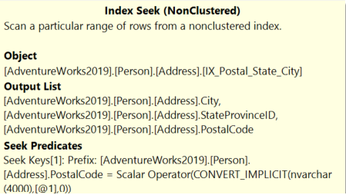
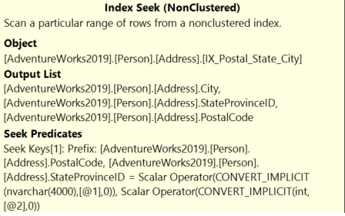
Multi-Column Indexing Access (Seek Predicates)
--Single value performs Index Seek.
SELECT City, StateProvinceID, PostalCode
FROM Person.Address
WHERE PostalCode = '98011'
--Index Seek on both columns
--Search condition in same order as Index.
SELECT City, StateProvinceID, PostalCode
FROM Person.Address
WHERE PostalCode = '98011' AND StateProvinceID = 79
Notes:
When trying to decide whether your index should be on Col1, Col2 or Col2, Col1 (or both), remember that even though SQL Server performs best when it can seek the index, scanning the index may still perform a lot better than scanning the clustered index.
That Is because the clustered index holds all the data for the rows and is therefore typically much larger than any nonclustered index, which typically only has a few columns.
Therefore, if you are frequently searching for Col1 or Col1, Col2, and only occasionally searching for Col2, it may be OK to accept the index scan needed when you do query Col2 alone, instead of creating both indexes and incurring that maintenance and DML overhead.

Slide 37
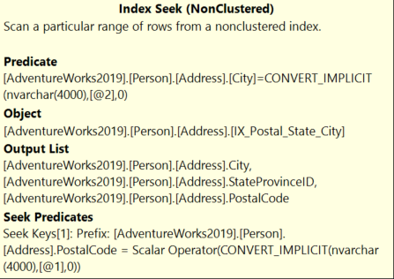
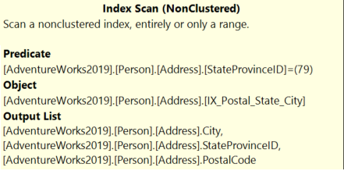
Multi-Column Indexing Access (Scan Predicates)
--Search condition not in same order as Index.
--Performs Index Scan.
SELECT City, StateProvinceID, PostalCode
FROM Person.Address
WHERE StateProvinceID = 79
--Index Seek on first column
--After seek, will scan second column
SELECT City, StateProvinceID, PostalCode
FROM Person.Address
WHERE PostalCode = '98011' AND City = 'Bothell'
Notes:
When trying to decide whether your index should be on Col1, Col2 or Col2, Col1 (or both), remember that even though SQL Server performs best when it can seek the index, scanning the index may still perform a lot better than scanning the clustered index.
That Is because the clustered index holds all the data for the rows and is therefore typically much larger than any nonclustered index, which typically only has a few columns.
Therefore, if you are frequently searching for Col1 or Col1, Col2, and only occasionally searching for Col2, it may be OK to accept the index scan needed when you do query Col2 alone, instead of creating both indexes and incurring that maintenance and DML overhead.

Slide 38
Demonstration
Multiple Column Indexes
Demonstrate seeks and scans with multiple column indexes.
Notes:
Previous demonstration files are under E:\Archived.
You can open all the demonstrations by using the solutions file :
E:\Demos\SQL_PTO_Workshop_Demos.ssmssln
Individual SQL demo files.
E:\Demos\05_Indexing_Strategy\NCI_Column_Order

Slide 39
The Tipping Point (Seeks vs Scans)
Selective Query
Tipping Point
Lookups are expensive
Pages
1/4
1/3
Point where the number of rows returned is no longer selective enough to justify the I/O being done.
SQL Server chooses to convert what could be a SEEK + LOOKUP into a SCAN.
The “tipping point” is between 1/4 and 1/3 of the number of row relative to the number of total pages.
Page Density (Row per page) does have an impact on the “tipping point”

Slide 40
Demonstration
The Tipping Point
Demonstrate seeks vs scans.
Notes:
New demonstration needs created.

Slide 41
Questions?

Slide 42
Lesson 3: Index Monitoring and Fragmentation

Slide 43
Objectives
After completing this learning, you will be able to:
Monitor index usage.
Describe page splits.
Understand problems caused by page splits.
Monitor index fragmentation and free space.
Review options to remove fragmentation and free space.

Slide 44
Why to monitor Index usage
Data access and distribution changes over time.
By reviewing index usage, we can ensure that the indexes are appropriate for the current workload.
Use sys.dm_db_index_usage_stats and sys.dm_db_index_operational_stats to monitor index usage.
Database standard report also monitors Index usage and Physical Statistics.
Notes:
Key Points:
Understanding how indexes are used can help adjust indexing approaches in several ways.
You may find indexes that are not used, and be able to drop or disable them.
You may find clustered indexes that are scanned instead of sought, which could be fixed by adjusting the query.
You may find indexes that are used only at month end, and add them just when needed to reduce the impact on DML and index maintenance.
Sys.dm_db_index_usage_stats gives information about overall access methods to your indexes.
sys.dm_db_index_physical_stats DMF returns information about the lower-level I/O activities, like INSERT, UPDATE and DELETE operations, occurred on the index, per each table partition.
Database Reports
References: https://docs.microsoft.com/en-us/sql/relational-databases/system-dynamic-management-views/sys-dm-db-index-usage-stats-transact-sql?redirectedfrom=MSDN&view=sql-server-ver15

Slide 45
Clustered Index usage patterns
Pattern | Interpretation
Seeks, but no scans | May not need maintenance. Seeks are not impacted by fragmentation
Clustered index with High number of scans | Review missing index recommendations. Consider changing Clustering key. Simplify queries with complex WHERE clauses
Clustered index with Low number of seeks and high number of lookups | May need to change Clustering Key Look how often bookmark lookups occur.

Slide 46
Non-Clustered Index usage patterns
Pattern | Interpretation
Seeks, but no scans | May not need maintenance. Seeks are not impacted by fragmentation
Non-Clustered index with High number of scans | Consider compression. Check for non-SARGable queries. Review missing index recommendations
Index with No/low usage | May be able to drop or disable index
Non-Clustered Index Used at specific times only | May be able to drop index, recreate when needed

Slide 47
sys.dm_db_index_usage_stats
Tracks seeks, scans, and lookups
Provides date of last access
Counters are incremented once per query execution
User and system access (such as index rebuilds) are tallied separately
Counters are initialized to 0 when SQL Server service restarts
SELECT
Distinct OBJECT_NAME(Indx.OBJECT_ID) Table_Name ,Indx.name IndexName
,Indx.type_desc IndexType,Iusg.user_seeks Seeks,Iusg.user_scans Scans
,Iusg.user_lookups Lookups ,Iusg.user_updates Updates ,Iusg.last_user_seek LastSeek
,Iusg.last_user_scan LastScan,Iusg.last_user_lookup LastLookup ,Iusg.last_user_update LastUpdate
FROM
SYS.INDEXES Indx
INNER JOIN SYS.DM_DB_INDEX_USAGE_STATS Iusg
ON Iusg.index_id = Indx.index_id AND Iusg.OBJECT_ID = Indx.OBJECT_ID
INNER JOIN SYS.DM_DB_PARTITION_STATS PrtSts
ON PrtSts.object_id=Indx.object_id
WHERE
OBJECTPROPERTY(Indx.OBJECT_ID,'IsUserTable') = 1
Notes:
Key Points:
Sys.dm_db_index_usage_stats gives information about overall access methods to your indexes.
The user_updates counter indicates the level of maintenance on the index caused by insert, update, or delete operations on the underlying table or view.
Whenever a database is detached or is shut down (for example, because AUTO_CLOSE is set to ON), all rows associated with the database are removed.
=============
More Information
=============
Note:
sys.dm_db_index_usage_stats does not return information about memory-optimized indexes. For information about memory-optimized index use, see sys.dm_db_xtp_index_stats (Transact-SQL).
To call this view from Azure Synapse Analytics (SQL DW) or Parallel Data Warehouse, use sys.dm_pdw_nodes_db_index_usage_stats.
References: https://docs.microsoft.com/en-us/sql/relational-databases/system-dynamic-management-views/sys-dm-db-index-usage-stats-transact-sql?redirectedfrom=MSDN&view=sql-server-ver15

Slide 48
sys.dm_db_index_operational_stats
Returns information about the lower-level I/O activities
Takes database_id, the object_id, the index_id and the partition_number as parameters
Memory-optimized indexes do not appear in this DMV
SELECT
*
FROM
SYS.DM_DB_INDEX_OPERATIONAL_STATS (NULL,NULL,NULL,NULL ) opsts
INNER JOIN SYS.INDEXES AS Indx
ON Indx.[OBJECT_ID] = opsts.[OBJECT_ID]
AND Indx.INDEX_ID = opsts.INDEX_ID
WHERE
OBJECTPROPERTY(opsts.[OBJECT_ID],'IsUserTable') = 1
Notes:
Consider demonstrating SQL demo file.
E:\Demos\05_Indexing_Strategy\Index_Operational_Stats.sql
Key Points:
sys.dm_db_index_operational_stats : Operational stats provides good, low-level data that is useful for diagnosing different sorts of problems. For example, you can track IO latency, lock escalations, and page compression failures or how many INSERT, UPDATE and DELETE operations, occurred on that index/ per each table partition.
Default parameter value is null.
You can use sys.dm_db_index_operational_stats to track the length of time that users must wait to read or write to a table, index, or partition, and identify the tables or indexes that are encountering significant I/O activity or hot spots.
Data is neither persistent nor transactionally consistent. This means you cannot use these counters to determine whether an index has been used or not, or when the index was last used.
=============
More Information
=============
Note:
sys.dm_db_index_operational_stats does not return information about memory-optimized indexes. For information about memory-optimized index use, see sys.dm_db_xtp_index_stats (Transact-SQL).
Referenceshttps://docs.microsoft.com/en-us/sql/relational-databases/system-dynamic-management-views/sys-dm-db-index-operational-stats-transact-sql?view=sql-server-ver15

Slide 49
sys.dm_db_index_physical_stats
Returns size and fragmentation information for the data and indexes of the specified table or view in SQL Server.
Takes database_id, the object_id, the index_id and the partition_number as parameters
Memory-optimized indexes do not appear in this DMV
SELECT OBJECT_SCHEMA_NAME(I.object_id) AS SchemaName, OBJECT_NAME(I.object_id) AS TableName, I.name, I.Index_ID, IPS.partition_number, IPS.avg_fragmentation_in_percent,
IPS.page_count, IPS.avg_page_space_used_in_percent
FROM sys.indexes as I
INNER JOIN sys.dm_db_index_physical_stats(DB_ID(), NULL, NULL, NULL, 'Limited') as IPS
ON I.object_id = IPS. object_id
AND I.index_id = IPS.index_id
--WHERE IPS.avg_fragmentation_in_percent >30
--AND IPS.page_count >1000
Notes:
sys.dm_db_index_physical_stats (Transact-SQL) - SQL Server | Microsoft Docs
Consider demonstrating SQL demo file.
E:\Demos\05_Indexing_Strategy\Index_Fragmentation.sql

Slide 50
SQL Index Fragmentation and Maintenance options
SSMS -> Index Physical Statistics report
Will report fragmentation and recommend solution at database level
Custom Solution
Find fragmentation using Sys.dm_db_index_physical_stats
Correct fragmentation
Can remove Index fragmentation using Rebuild or Reorganize option
 | ALTER INDEX… REBUILD | ALTER INDEX … REORGANIZE
Removes fragmentation | X | X
Removes free space | X
Resets fill factor | X
Updates statistics | X
Notes:
Key points:
Maintenance plans are simple options, but they do not scale well.
All indexes in a database will be maintained, whether they need to be or not.
To manage a manual approach, you will generally follow two steps:
Use a DMV to calculate the fragmentation for each index.
Write a script to loop over the results and maintain the indexes that need it.
Remove index Fragmentation
Rebuild - Drops and re-creates the index.
For rowstore indexes, rebuilding removes fragmentation, reclaims disk space by compacting the pages based on the specified or existing fill factor setting, and reorders the index rows in contiguous pages.
For columnstore indexes, rebuilding removes fragmentation, moves all rows into the columnstore, and reclaims disk space by physically deleting rows that have been logically deleted from the table.
Reorganize - Uses minimal system resources and is an online operation. No long-term blocking table locks. it defragments the leaf level of clustered and nonclustered indexes on tables and views by physically reordering the leaf-level pages to match the logical, left to right, order of the leaf nodes.
Recommendations
avg_fragmentation_in_percent value Corrective statement
>5% and < = 30% ALTER INDEX REORGANIZE
> 30% ALTER INDEX REBUILD WITH (ONLINE = ON/OFF)
=============
More Information
=============
DMV
Sys.dm_db_index_physical_stats
( { database_id | NULL | 0 | DEFAULT } , { object_id | NULL | 0 | DEFAULT } , { index_id | NULL | 0 | -1 | DEFAULT } , { partition_number | NULL | 0 | DEFAULT } , { mode | NULL | DEFAULT } )
sys.dm_db_index_physical_stats requires only an Intent-Shared (IS) table lock, regardless of the mode that it runs in.
Scanning Modes: LIMITED, SAMPLED or DETAILED
The LIMITED mode is the fastest mode and scans the smallest number of pages. For an index, only the parent-level pages of the B-tree (that is, the pages above the leaf level) are scanned. For a heap, the associated PFS and IAM pages are examined and the data pages of a heap are scanned in LIMITED mode.
The SAMPLED mode returns statistics based on a 1 percent sample of all the pages in the index or heap. Results in SAMPLED mode should be regarded as approximate. If the index or heap has fewer than 10,000 pages, DETAILED mode is used, instead of SAMPLED.
The DETAILED mode scans all pages and returns all statistics – both fragmentation as well as free space available on the index.
The modes are progressively slower from LIMITED to DETAILED, because more work is performed in each mode.
It is rare to use DETAILED mode in larger databases, because it requires reading all the pages in the database. Therefore, database administrators (DBAs) often are unaware of how much free space is currently available in indexes.
For a good example of the logic required to write a custom solution, see https://ola.hallengren.com/
Rebuilding indexes accomplishes much more than reorganizing, but that comes at a cost.
Rebuilds are more intensive, potentially using tempdb resources, causing high I/O, and causing log growth. The larger the table, the more likely these are to become issues. This is because rebuilding indexes moves all the data on the pages around, in order to eliminate free space. This is done in a single transaction, which can cause the log to fill.
Reorganize
In contrast, reorganize works by locking two pages that are out of order, swapping them, and then releasing the locks. This is a very quick process, and each swap is a separate transaction.
Like most processes that work “one at a time”, reorganizes can take longer than rebuilds. Therefore, reorganizes typically are saved for indexes that are less than 30% fragmented. In these cases, the reduced IO requirements (<30% of all pages versus 100% of pages for rebuilds) keeps the impact of the reduced efficiency in check.
Note that REORGANIZE does not remove free space. If DBAs maintain indexes well, many indexes may never reach 30% fragmentation. Therefore, they never get rebuilt, and free space can grow significantly over time. Because the physical stats DMV is rarely run in DETAILED mode, free space problems are rarely observed. It may be a good idea to check for free space occasionally, or track indexes that are not rebuilt, so that they can be manually rebuilt over time to reclaim free space.
References:
https://docs.microsoft.com/en-us/sql/relational-databases/indexes/reorganize-and-rebuild-indexes?view=sql-server-ver15

Slide 51
Fill Factor
Can address performance issues due to fragmentation.
Reducing logical fragmentation.
Low fragmentation
High seeks and low scans
Index is not scanned
Use When
Specifying the amount of free space on a data or index page.
Do not use when
ALTER INDEX [pk_bigProduct]
ON [dbo].[bigProduct]
REBUILD WITH (PAD_INDEX = ON, FILLFACTOR = 90)
Notes:
Key Notes:
Setting a default fill factor is not a great approach, because the increase in total pages needed to store an index can be costly.
When deciding to set a fill factor, think about the following:
If low fragmentation, do not use fill factor.
If high seeks and low scans, do not use fill factor. Fragmentation only affects scans.
Therefore, if the index is not scanned, fragmentation is not as important, and fill factor is likely not needed.
If high fragmentation, test and see.
If fragmentation is causing performance issues, fill factor is one way to address it.
However, fill factors leave free space on a page, which is going to increase the total number of pages needed to store the index.
It is a trade-off, will a scan of the less fragmented index, with more sequential reads perform better?
Or will the scan of fewer data pages perform better?
Performance is going to vary, depending on the index.
=============
More Information
=============
How to tell?
Indexes on ascending values do not fragment.
Use sys.dm_db_index_stats for seek vs scan usage.
Collect fragmentation history as part of index maintenance.
How to set fill factor?
Option in CREATE INDEX and ALTER INDEX…REBUILD.
Once set, future REBUILDs will respect the setting until it is manually changed.
Techniques used to reduce fill factor, which have been discussed earlier in this lesson.
The exception is minimizing updates. This is not an indexing issue, but can definitely impact fragmentation.
Update in sets, rather than one at a time.
Do not insert with immediate update. Typically, this is done to look up values in other tables. Backfilling null values with the values looked up can increase the chance that the pages just added will not fit after the update.

Slide 52
Reducing fragmentation
Reducing Fragmentation
Using an ascending key (not always possible).
Using an appropriate fill factor for the workload.
Update in sets, rather than one at a time.
Do not insert with immediate update.
Notes:
Key Notes:
Choosing Indexes
Always evaluate duplicate/redundant/similar indexes before creating new index, technique called Index consolidation.
sys.dm_db_missing_index_details
sys.dm_db_index_usage_stats
Reducing Fragmentation
This slide goes over some of the techniques used to reduce fill factor, which have been discussed earlier in this lesson.
The exception is minimizing updates.
This is not an indexing issue, but can definitely impact fragmentation.
Update in sets, rather than one at a time.
Do not insert with immediate update. Typically, this is done to look up values in other tables. Backfilling null values with the values looked up can increase the chance that the pages just added will not fit after the update.

Slide 53
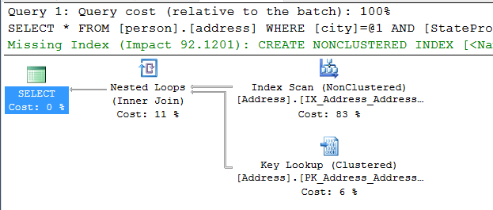
Missing Index Recommendations
SQL Server identifies indexes that would help a query’s performance
The recommendation is included in the query plan
The cost savings are aggregated in DMVs to help identify the most beneficial indexes
Notes:
Key points:
Reviewing index usage is a great way to decide which indexes are not needed. However, you also need a way to find indexes that need to be added.
To support this, Microsoft SQL Server identifies indexes that would benefit a query when the query is being compiled, and includes it in the query plan. In addition, SQL Server keeps a running tally of the total cost benefit to the query. As queries are executed more often, the total cost saving grows. Doing so lets you prioritize the indexes that need to be added.
Database Tuning Advisor makes index recommendations as well.

Slide 54

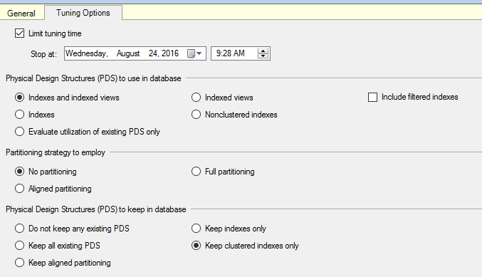
Choosing Indexes
Following sources can help you choosing indexes
Missing Index recommendations
sys.dm_db_index_usage_stats
Database Tuning Advisor
Notes:
Key Notes:
Choosing Indexes
Always evaluate duplicate/redundant/similar indexes before creating new index , technique called Index consolidation.
sys.dm_db_missing_index_details –>covered in detail in upcoming chapter.
sys.dm_db_index_usage_stats –>covered in detail in upcoming chapter along with operational stats.
Reducing Fragmentation
This slide goes over some of the techniques used to reduce fill factor, which have been discussed earlier in this lesson.
The exception is minimizing updates.
This is not an indexing issue, but can definitely impact fragmentation.
Update in sets, rather than one at a time.
Do not insert with immediate update. Typically, this is done to look up values in other tables. Backfilling null values with the values looked up can increase the chance that the pages just added will not fit after the update.

Slide 55
Demonstration
Analyzing Index Usage
Show how index usage patterns can help identify index and query improvements.
Notes:
Previous demonstration files are under E:\Archived.
You can open all the demonstrations by using the solutions file :
E:\Demos\SQL_PTO_Workshop_Demos.ssmssln
Individual SQL demo files.
E:\Demos\05_Indexing_Strategy\Index_Usage01,sql
E:\Demos\05_Indexing_Strategy\Index_Usage02,sql

Slide 56

Index Maintenance
Identifying and removing physical index fragmentation
Notes:
The files for this Lab are located at E:\Labfiles\M05L05Lab01
Link to lab: Use electronic material to complete the lab exercise “Index Maintenance”

Slide 57
Questions?

Slide 58
Knowledge Check
Which DMV/DMF are used to monitor index usage?
Does it make sense to add all SQL Server missing recommendations?
When Managed Lock Priority should be used?
Notes:
Answer 1:
sys.dm_db_index_usage_stats DMV and sys.dm_db_index_operational_stats DMF are used to monitor index usages.
Answer 2:
No it is not wise. Focus on the most beneficial ones, based on total cost savings may top 10. Compare those indexes against other recommendations for the same tables and against existing indexes to see if consolidating them give benefits, or to remove an existing index when adding a recommended one that is similar.
Answer 3:
MLP is used for online Indexes.

